Slide 1

Exploring the Trends in the Suicide Rate of Demographic Groups in the United States
Presented by:
Christopher Kalfas
Daniel Bowen
Jason Chicatelli
Kyriaki Karalis

Slide 2

In this project, we aim to show the correlation of poverty & access to guns, to suicide rates throughout the US.
Notes:
Motivation for our project

Slide 3
Motivations, Questions and Assumptions
Is poverty a factor?
How does state poverty rate relate to the suicide rate of the state?
Is demographic a factor in suicide rate?
Access to gun dealers.
Suicide rates, especially among white males compared to number of gun stores
Notes:
Determine suicide rates for different demographic groups in the US and what percentage of the suicides are by gun. Then compare the suicides to proximity to a gun dealer. (you’ll find more suicides where you’ll find more gun retailers) additional
Talk about the Suicide Belt & the proximity of poverty to increased suicide rate (Suicide Belt on next slide.
What are the suicide rates for different demographic groups in select US counties (separated by men and women)?
Of those suicides found, what percentage are committed using guns?
Finally, in those counties, are there an abundance of gun dealers?

Slide 4
Data Cleanup & Exploration
Data was obtained from the following sources:
Bureau of Alcohol, Tobacco, and Firearms (atf.gov)
Centers for Disease Control and Prevention (cdc.gov)
Wikipedia for location based information
Google for mapping information
Notes:
*Note: Google does not include guns shops as a searchable field for the Google Map API.

Slide 5

Issues in Data Gathering
Exploration and cleanup process
Data cleanup issues:
Converting county/city information into numerical data
Correcting errors
Limiting Scope Creep
Notes:
Problems in data gathering:
Converting county/city names into numerical data (longitude & latitude) for use with Google API
Correcting errors from sloppy data (i.e, typos in data create search errors)
Limiting the scope of the investigation– scope creep was real in this project.

Slide 6

Data Cleaning, Analizing & Presentation
Jupyter Notebooks
Notes:
OPEN JUPYTER NOTEBOOKS NOW & Discus how we divvied up info gathering responsibilities & how we got what we got.
Discuss the steps you took to analyze the data and answer each question you asked in your proposal
Present and discuss interesting figures developed during analysis, ideally with the help of Jupyter Notebook

Slide 7
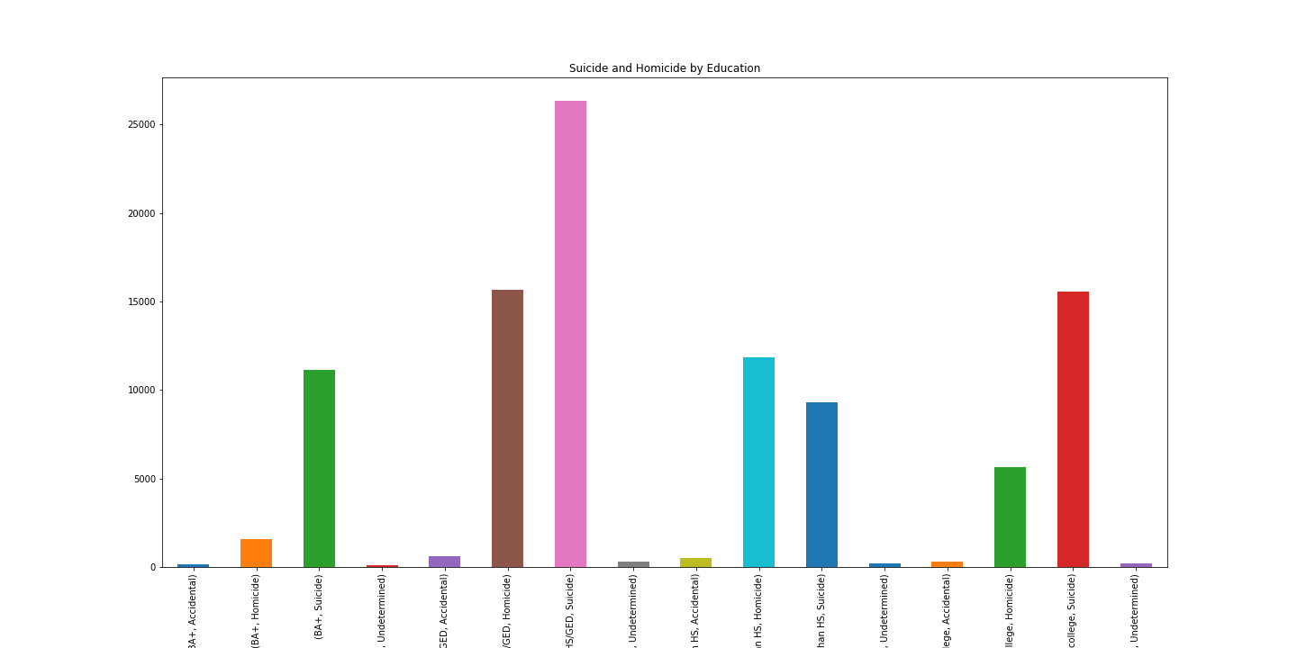
Notes:
Since we looked at poverty in states,

Slide 8
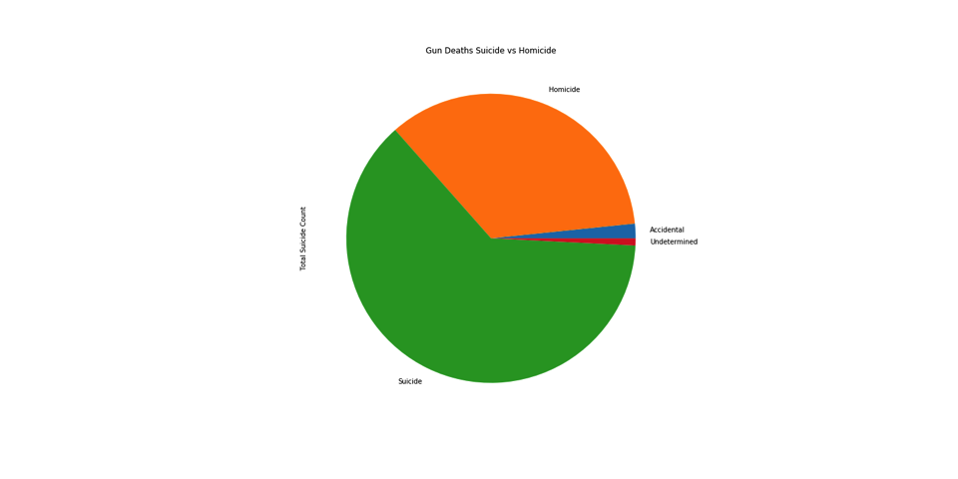
Gun Deaths: Suicide vs. Homicide

Slide 9
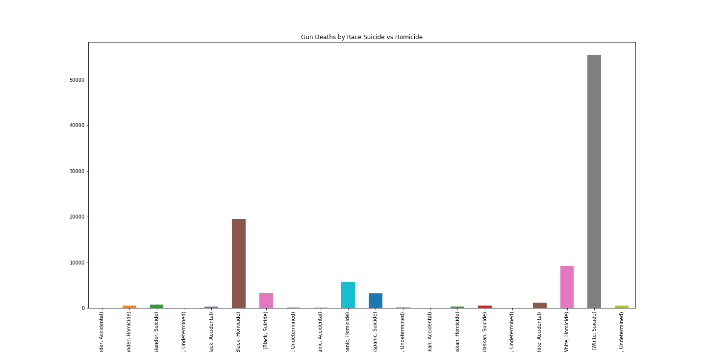
Gun Deaths by Race: Suicide vs. Homicide

Slide 10
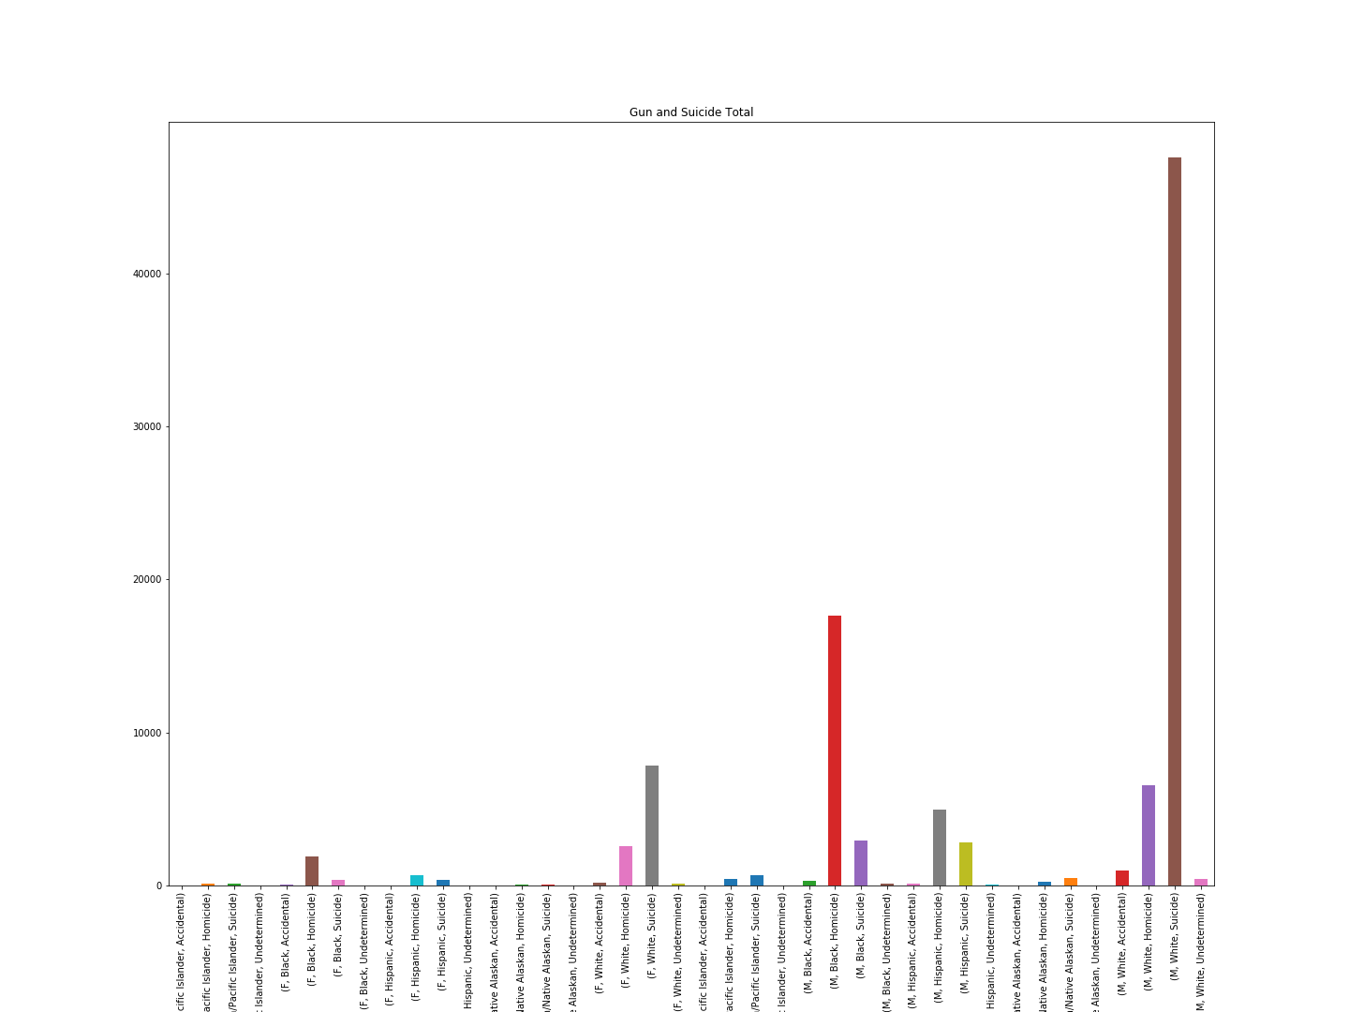
Gun & Suicide Total

Slide 11


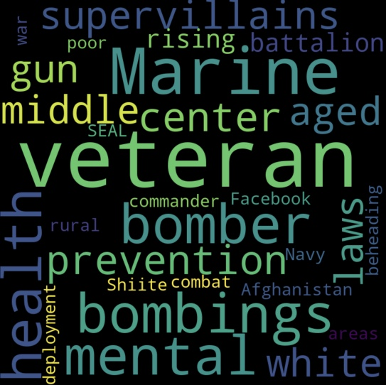
Word clouds from NYT API
1999
2015
2008
Notes:
Click to get animated years & images. It’s magic.

Slide 12
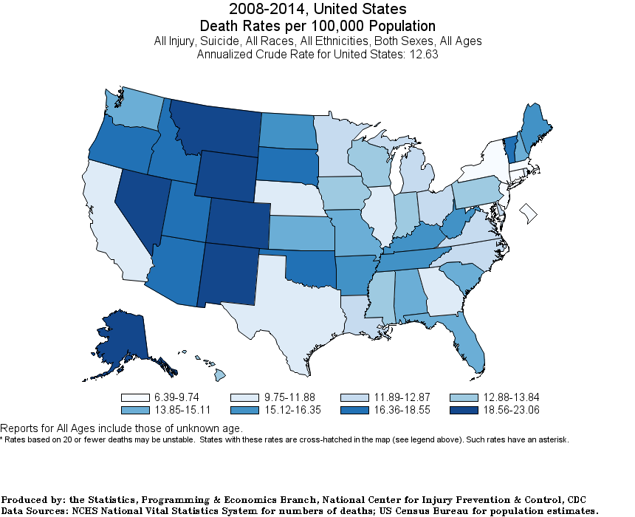
Trends in Suicide Rates
Notes:
Do we need this slide twice?

Slide 13
Trends In Suicide – CDC Wisqars Data Map
Notes:
CHRIS
Wisqars is the CDC’s data acquisition website where you can request specific data by disease or injury and narrow down by state or county.

Slide 14
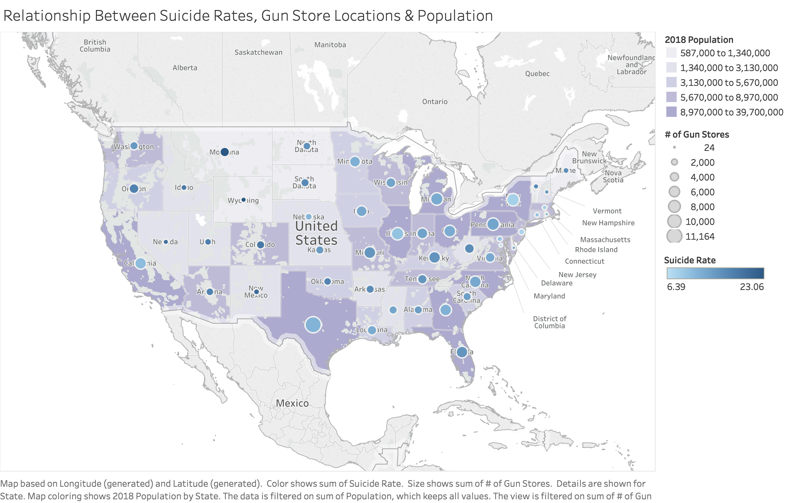
Suicide Rates, Gun Stores & Population
Notes:
KYRIAKI
This map shows:
Population– auto generated from Tableau, 2008. Darkper purple – more population
# of Gun Stores – Circles in middle of each state. The larger the circle, the more gun stores.
Suicide Rate– from the CDC. Rate is per 100,000 people. Rate is expressed by fill in the circles with darker being a higher suicide rate.

Slide 15
findings
Suicide by gun does seem more common in places where guns are more abundantly available, even when accounting for population.
Suicide rate seems to go up when poverty rate goes up, but not for everyone.
Suicides among white males is disproportionately higher than in any other demographic.
Suicide among black & brown people is extremely low.
Notes:
What we didn’t get into because of scope creep, was WHY all these findings

Slide 16

Difficulties & Additional Questios …or, THE Post Mortem Slide
Difficulties
Additional areas for exploration
Effect of access to mental health services
Effect of social stigmas regarding discussion about suicide
Notes:
Difficulties:
Data collection issues re: using Google Maps API for gun store locations & Suicide Locations
Suicides are recorded in US Cencus/CDC data by *county only, not specific location and do not include latitude & longitude.

Slide 17

Exploring the Trends in the Suicide Rate of Demographic Groups in the United States
QUESTIONS?

